Slide 1
Phishing Website Classification
Submitted in the partial fulfillment for the award of the degree of
BACHELOR OF ENGINEERING
IN
Computer Science (IoT)
Submitted by:
Ritesh Mahato(18BCS4552),Sunny Kumar
(18BCS4555),Gaurav Kumar(18BCS4557)
Under the Supervision of:
Prof. Rajat Tiwari
Department of AIT-CSE
DISCOVER . LEARN . EMPOWER

Slide 2
Outline
Introduction to Project
Problem Formulation
Objectives of the work
Methodology used
Results and Outputs
Conclusion
Future Scope
References

Slide 3
Introduction to Project
Phishing is the most commonly used social engineering and cyber attack.
• Through such attacks, the phisher targets naïve online users by tricking them into revealing confidential information, with the purpose of using it fraudulently.
• Of the above three, the machine learning based method is proven to be most effective than the other methods.
• Even then, online users are still being trapped into revealing sensitive information in phishing websites

Slide 4
Problem Formulation
Around 83% of IT teams in Indian organizations said the number of a phishing attack targeting their employees increased during 2020.
According to the findings of a global survey titled ‘Phishing Insights 2021’ by Sophos, a cybersecurity company.
Phishing has been making an enormous impact on data privacy over the past two decades.
Phishing falls under Social Engineering Attacks. In phishing, the confidential data of an individual, group, or organization is obtained through online fraud.

Slide 5
Objectives of the Work
A phishing website is a common social engineering method that mimics trustful uniform resource locators (URLs) and webpages.
The objective of this project is to train machine learning models and deep neural nets on the dataset created to predict phishing websites.
Both phishing and benign URLs of websites are gathered to form a dataset and from them required URL and website content-based features are extracted. The performance level of each model is measures and compared.

Slide 6
Methodology used
MACHINE LEARNING MODELS
• This is a supervised machine learning task. There are two major types of supervised machine learning problems, called classification and regression.
• This data set comes under classification problem, as the input URL is classified as phishing (-1) or legitimate (1).
The machine learning models (classification) considered to train the dataset in this notebook are:
• Random Forest Classifier

Slide 7
Random Forest Classifier
It works in four steps:
Select random samples from a given dataset.
Construct a decision tree for each sample and get a prediction result from each decision tree.
Perform a vote for each predicted result.
Select the prediction result with the most votes as the final prediction.

Slide 8
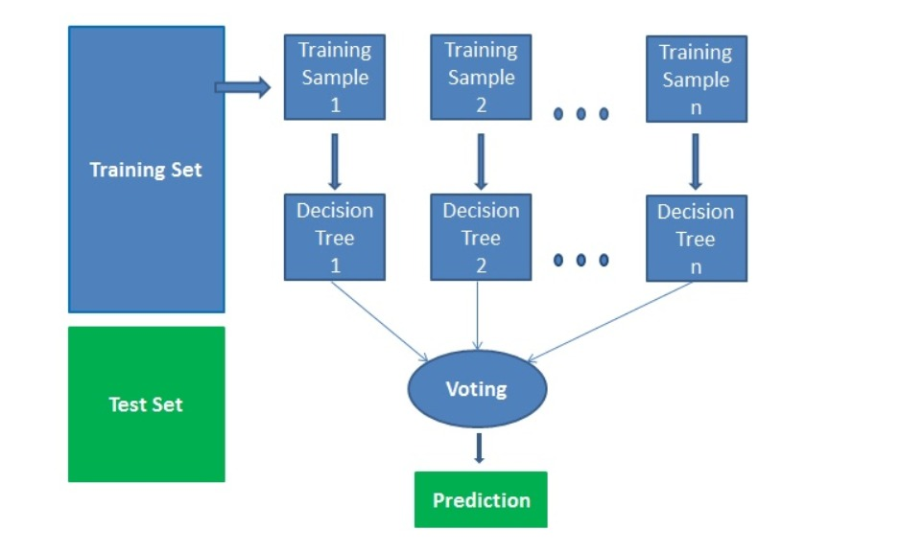

Slide 9
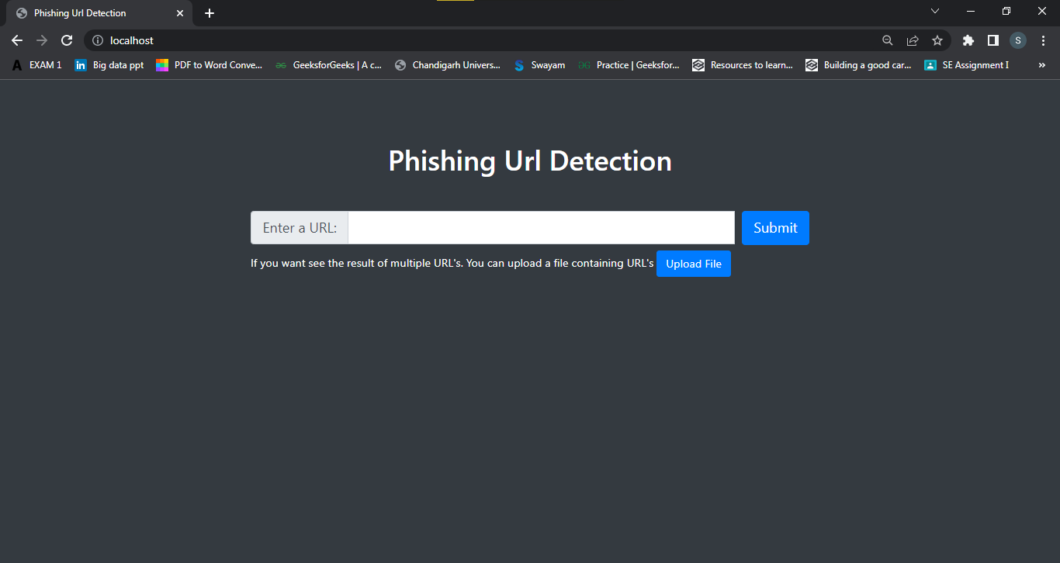
Results and Outputs

Slide 10
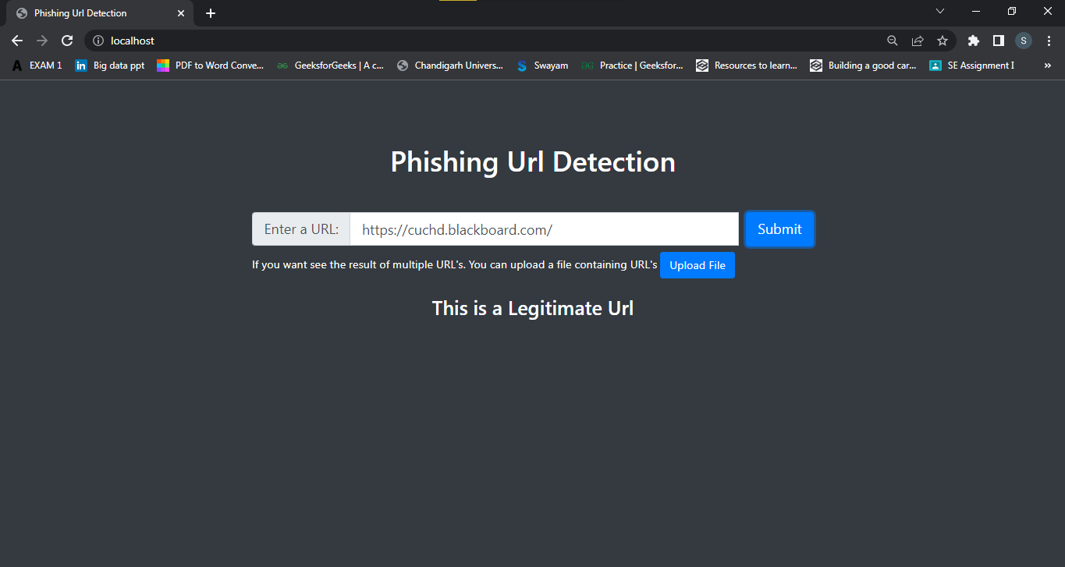

Slide 11
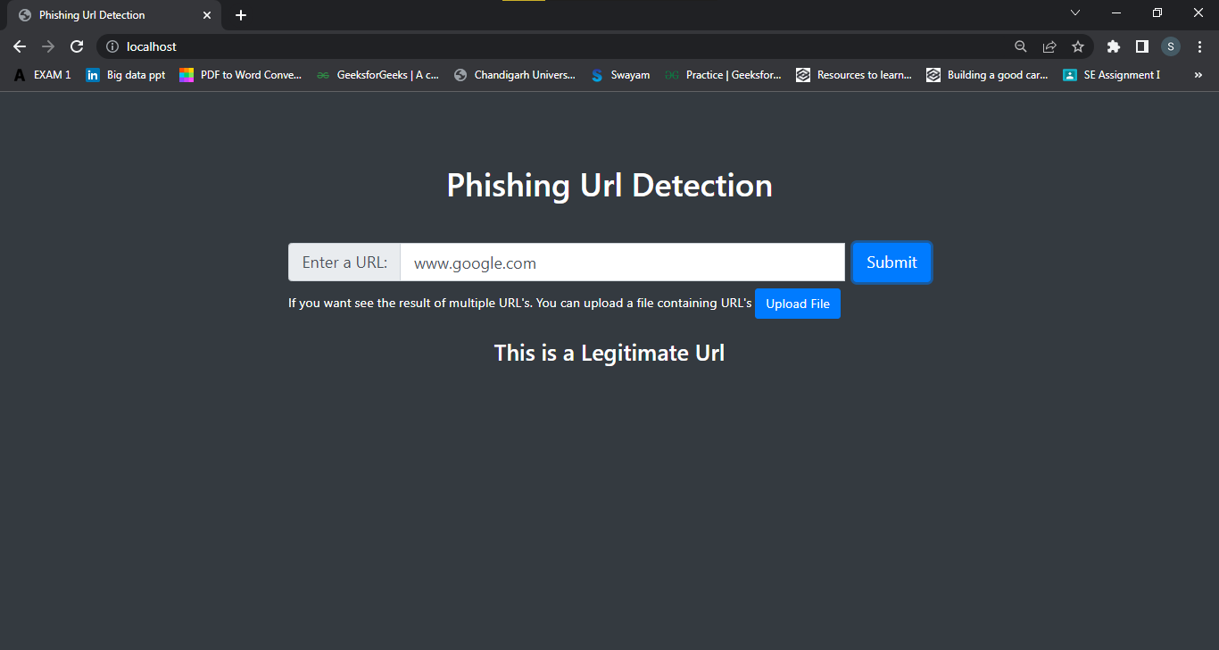

Slide 12


Slide 13


Slide 14
Conclusion
Working on this project is very knowledgeable and worth the effort.
Through this project, one can know a lot about the phishing websites and how they are differentiated from legitimate ones.
These should classify the inputted URL to legitimate or phishing with the use of the saved model.
Learn about Random Forest Classification how it should be helpful to solve real world problems.

Slide 15

How to Avoid Phishing Attacks
STAY INFORMED
Learn about new phishing techniques that are being developed to avoid falling prey to one.
1
THINK BEFORE YOU CLICK
Never click on hyperlinks without examining the hidden URL.
2
UTILIZE ‘Phishing Website’
When in doubt, use the ‘Phishing Website Classification’ website to verify the authenticity of a website.
3

Slide 16
Future Scope
In future if we get structured dataset of phishing we can perform phishing detection much more faster than any other technique.In future we can use a combination of any other two or more classifier to get maximum accuracy.
We also plan to explore various phishing techniques that uses Lexical features, Network based features, Content based features, Webpage based features and HTML and JavaScript features of web pages which can improve the performance of the system. In particular, we extract features from URLs and pass it through the various classifiers.

Slide 17
References
Hajgude, J., Ragha, L.: Phish mail guard: Phishing mail detection technique by using textual and URL analysis. In: 2012 World Congress on Information and Communication Technologies, pp. 297–302 (2012)
https://en.wikipedia.org/wiki/Machine_learning
www.ijacsa.thesai.org
https://link.springer.com/chapter/10.1007/978-981-13-9155-2_5

